Slide 1
Hidden Disabilities Sunflower Lanyard Scheme Launch
Project leads:
Hannah Sauer (she/her) EDI Project Officer
Barry Hayward (he/him) Deputy Head of Student Disability
Notes:
Links to share at the beginning/end:
Sunflower Awareness Training
Information for Staff/PGR on the Disability Inclusion Hub
Information for Students in SSO Article
Intranet Article: King’s joins the Hidden Disabilities Sunflower
NECESSARY

Slide 2
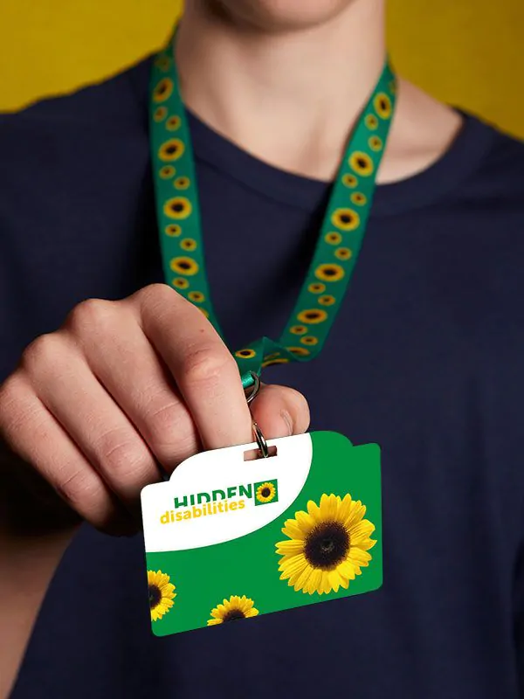
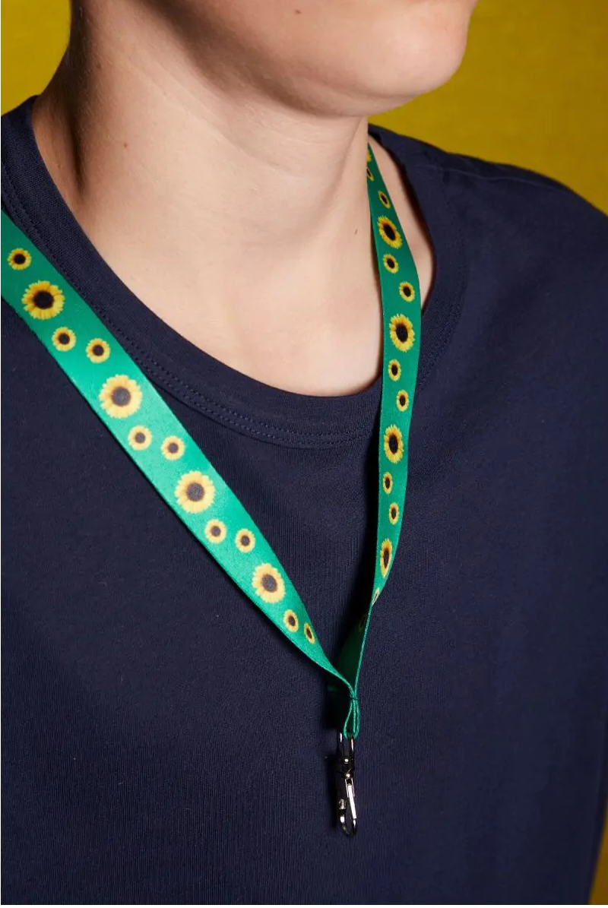
What is the Hidden Disabilities Sunflower?
A global initiative that started in UK airports and has since expanded – as you may know, we are now a member!
A tool to voluntarily make an unseen disability or condition known, so that the individual can access additional assistance, time and/or understanding.
One step in King’s journey towards better understanding and inclusion around non-visible conditions and disabilities.
Notes:
NECESSARY

Slide 3
At King’s, our goal is for the Sunflower to help us
Create inclusion through awareness, increasing our understanding of different conditions and most importantly, of how to reduce barriers
Make a tangible difference to colleagues and students with hidden disabilities or conditions
Create a space where more people feel happy to share their needs and experiences, opening up new conversations
Notes:
NECESSARY

Slide 4
Project Timeline
Procurement, Stakeholder Consultation
Planning:
Training
Distribution
Comms & Promotion
Resourcing:
Training
Signposting
Promotion
Continued Promotion, training and distribution
Sunflower Lanyards, training and awareness embedded into King’s Culture. Continued evaluation and development.
Launch
Launch Comms
Distribution Push
Awareness push
June
July, August
Sep, Oct
Nov – Aug ‘24
Sept ‘24 Onwards
More targeted support within faculty and student facing spaces is being scheduled from the start of the new calendar year, so do reach out to Hannah & Barry!
Notes:
NECESSARY

Slide 5
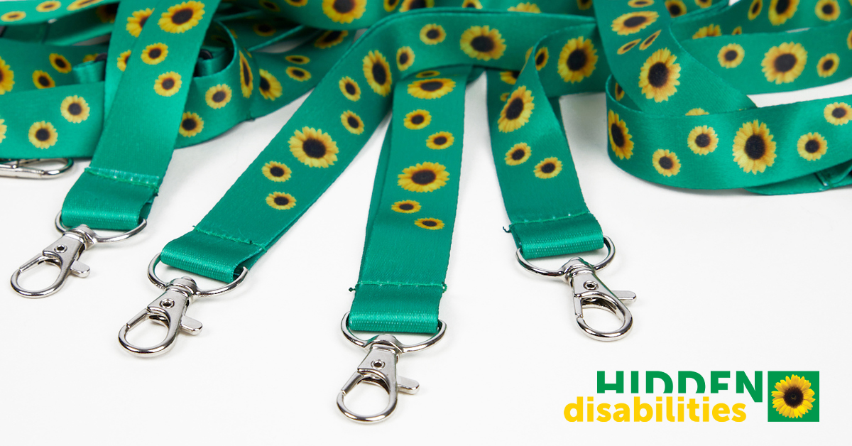
What Sunflower tools can I easily access?
On the Disability Inclusion Hub Sunflower page, under digital media resources!
Notes:
NECESSARY

Slide 6
Where are lanyards distributed from?
Campus | Location
Denmark Hill | WEC Reception IoPPN Reception
Guys | New Hunt’s House Reception Lavington Street Floor 4 Reception Hodgkin Building Reception
Strand | Bush House SE Reception Strand Building Security Reception
St Thomas | Gate 3 Security Desk
Waterloo | Franklin-Wilkins Building Reception
Also available | At Student Disability Support Drop-ins From Bronwen Wright at the Cornwall Service Centre
Just ask at any of these locations!
Notes:
NECESSARY

Slide 7
What can I expect at a distribution point?
A sign should be visible confirming this is a Sunflower distribution point. Distribution points are also advertised around site.
Staff have been trained. Just ask for a Sunflower lanyard and they should know what to do!
You may be asked if you are staff/student/visitor, but will not be asked any questions about your name or condition or asked for proof. Staff may also ask if you need any further assistance.
Notes:
OPTIONAL

Slide 8
The Sunflower is just one puzzle piece
The Hidden Disabilities Sunflower supports our wider programme of work to improve accessibility and disability inclusion at King’s.
Working to improve staff support by improving our workplace adjustments processes, introducing an individual adjustments plan and developing disability inclusion training for staff and managers.
Following the AccessAble audits of Strand and Denmark Hill, E&F have launched a series of works to improve the accessibility of the physical estate. Guy's and waterloo audits are taking place later this year.
The first changing places on campus have been launched!
E&F supported SED in launching the first step-free campus tours over Welcome Week which included a meeting with building managers to answer any accessibility questions
Fire evacuation lifts have been installed in parts of the campuses and work planned looking into improving E&F processes (e.g., The roll out of Safezone)
New “Creating an Accessible Campus" training launched for E&F Around 650 staff trained in 5-weeks over summer
Notes:
OPTIONAL, though if you don’t share this, please make a more general statement like “Joining the Sunflower is an important part of a wider programme to increase awareness of disability inclusion at King's. We are on a journey to ensure our staff and students have the support they need to succeed and this is one more step forward”

Slide 9
Hidden Disabilities Sunflower Awareness Training
10 minute video with some extra info, data collection and training evaluation questions
Embedded into a Microsoft Form to make data collection easy
Completion automatically generates a certificate to your email
Open to staff and students, though currently geared more at PS staff. Development to come so feedback welcome! (diversity@kcl.ac.uk)
Notes:
NECESSARY

Slide 10
Frequently Asked Questions
King’s lanyard vs. Sunflower lanyard
Can I wear the Sunflower outside of work?
When should I be wearing my Sunflower?
Find more information on supporting students on the Disability Inclusion hub (link will be shared at the end)
Notes:
1. As part of our security guidance, staff should be wearing their red King's lanyard at all times on site. However, you can add your Sunflower lanyard as well at any time! King's has made the decision to keep these as two separate lanyards so that it is easy for wearers to choose when they want to wear their Sunflower lanyard, regardless of when they need to wear their red King's lanyard.
2. Absolutely! The lanyards are recognised in many spaces outside of King 's, so please do feel empowered to use them whenever is most helpful to you.
You can also scroll down to search Sunflower friendly locations near to you at the Hidden Disabilities Sunflower Website.
3. Whenever you like! Wearing one or not wearing one is absolutely a choice. We are aware that Sunflower wearers may have different times when they do or don't feel like wearing their Sunflower, and we really want wearers to feel free and empowered to use it when it best suits them. We hope student-facing staff may feel comfortable to role model wearing theirs around students, but this is definitely not an expectation.
The Sunflower is also available as a pin badge, wrist band, which you may prefer.
If you don't have an invisible disability, and have completed your training video, then you can wear the ‘I support the Sunflower’ products.

Slide 11
Any questions or feedback?
Notes:
NECESSARY Links to paste into the chat of your meeting: Sunflower Awareness Training
Information for Staff/PGR on the Disability Inclusion Hub
Information for Students in SSO Article
Intranet Article: King’s joins the Hidden Disabilities Sunflower

Slide 12
Thanks for your time ☺
If you have any further questions or feedback, please don’t hesitate to get in touch
If you work in a department or team that you would like more support on this, please contact the project lead at
hannah.sauer@kcl.ac.uk
Notes:
Links to share at the beginning/end:
Sunflower Awareness Training
Information for Staff/PGR on the Disability Inclusion Hub
Information for Students in SSO Article
Intranet Article: King’s joins the Hidden Disabilities Sunflower

