Slide 2
Faculty of Life Sciences and Medicine Confidential Advisors

Slide 3
Confidential Advisors
Confidential Advisors are trained staff who support PhD students and staff within the Faculty of Life Sciences & Medicine who witness or experience bullying & harassment.
You can meet with an Advisor to confidentially discuss your situation and explore your options in an informal setting outside of any formal grievance process.
To speak to a Confidential Advisor:
Email folsm_confidentialadvisors@kcl.ac.uk (monitored by the FoLSM DDI team) or, Search our Confidential Advisors by name on the King’s Global Address List to contact them directly.
For more information, visit: internal.kcl.ac.uk/folsm-confidentialadvisors
For questions about bullying and harassment:
Contact the FoLSM Development, Diversity & Inclusion Team diversity-folsm@kcl.ac.uk

Slide 4
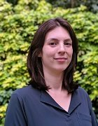
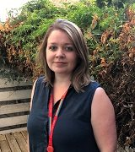
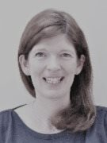
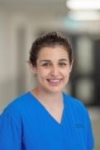
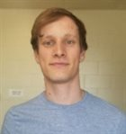
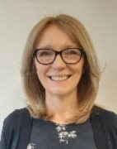
Our Team
Vicky Aerts
Sefina Arif
Julia Blower
Kate Bramham
Philippa Bridgen
Steven Cass
Sarah Double

Slide 5
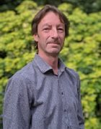
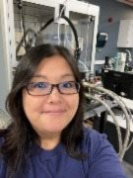
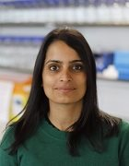
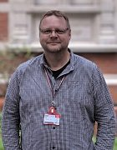
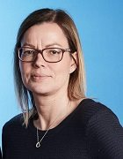
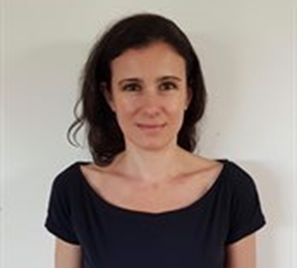
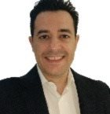
Our Team
Mark Holt
Risa Mori
Manasi Nandi
Richard Parsons
Natalie Prescott
Adelaide De Vecchi
Panicos Shangaris

Slide 6
Contact us: To speak to a Confidential Advisor: Email: folsm_confidentialadvisor@kcl.ac.uk For more information about Confidential Advisors, visit: internal.kcl.uk/folsm-confidentialadvisors. For questions about bullying & harassment contact the DDI Team diversity-folsm@kcl.ac.uk

Slide 7
Thank you
FoLSM Equality, Diversity & Inclusion Team
© 2020 King’s College London. All rights reserved

